Slide 1
Dew Introduction
Sigar

Slide 2
Agenda
Yesterday
Today
Tomorrow
The day after tomorrow

Slide 3
Yesterday
SparkPowerMeter is a tool.
Collect OS performance data by SSH.
Collect Spark driver log by integrating Spark application runnable script.
Build a set of data-flow based performance chart for Spark performance analysis.
Problem
Only used in small cluster because of SSH limitation.
Strong coupling with Spark application. Whatever Spark application or SparkPowerMeter throws exception, the total process would be redo.

Slide 4
Today
Dew is a light-weight distributed performance analysis framework.
Include all SparkPowerMeter features as an app component.
Support cluster performance analysis without big data job data flow.
No coupling with Spark application.
Loose coupling between different components, high extensibility.

Slide 5
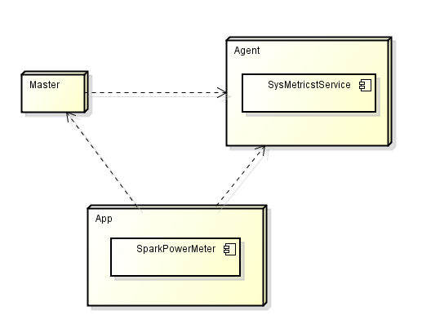
Dew Architecture

Slide 6
Tomorrow
Dew would be a big data application management and analysis system
Big data application management
Application registration and execution
Application execution result report
Spark log collection and analysis
Data-flow based spark performance analysis and diagnosis
Cluster log collection
Cluster log search based on Spark SQL

Slide 7
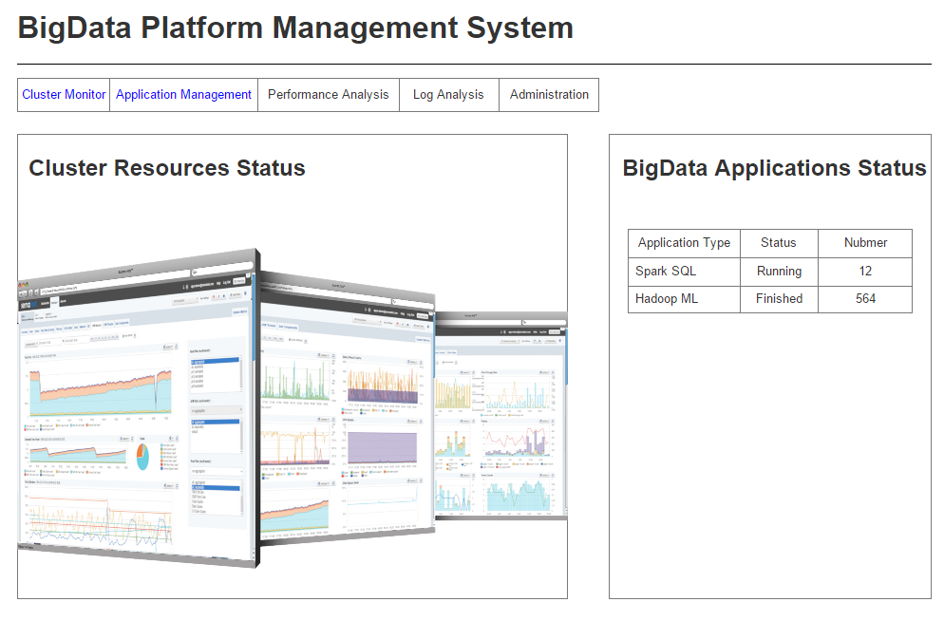

Slide 8
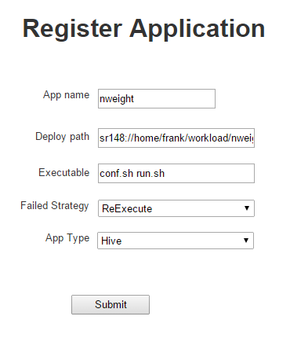

Slide 9
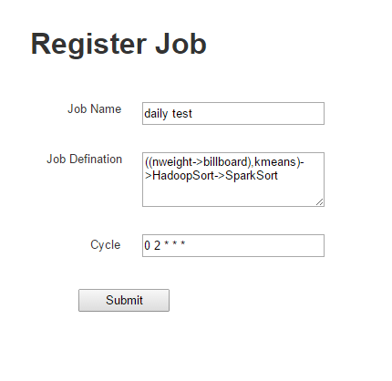

Slide 10
The day after tomorrow
Dew would be a Big Data Cloud management platform
Multi-cluster resource and Multi-platform application status monitor .
Resource Navigator based on computation resources monitor.
Automatic big data platform deployment.
Big data performance analysis and automatic tuning based on ML.
Notes:
One platform for all big data platform, Hadoop, spark, storm etc.

Slide 11

The day after tomorrow’s tomorrow
Dew would be the center of data center
Generalized data center log collection and analysis.
Generalized data center automatic operation.

